Slide 1

Python as an Additional Language
Lesson 4: Trying times

Slide 2
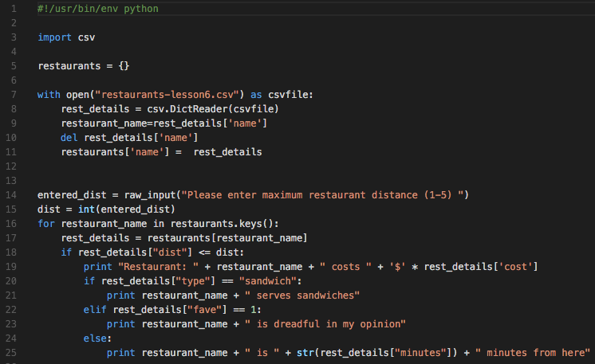

Where did we get to?

Slide 3
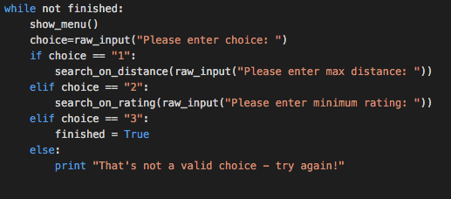
Adding in options
Let’s all start in the same place:
http://go/o-aa0f06

Slide 4
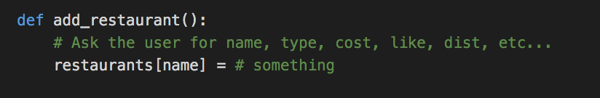
Before we go any further…
Add a new option – additional restaurant
Prompt for all the data we’ve got for our existing dataset
Store it in the restaurants dictionary
Here’s a hint to get you going:

Slide 5
What’s the problem?
There’s a problem with the data we’re prompting the user for
What is it?

Slide 6
What’s the problem?
There’s a problem with the data we’re prompting the user for
What is it?
Let’s add some validation! Any ideas as to how?
Validating all the inputs will take all session:
Add a few lines to check the score (out of 5) is valid.

Slide 7
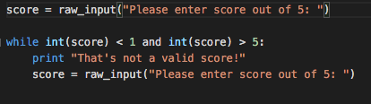
Did you come up with something like this?
Great! But there’s still a problem. What is it?

Slide 8
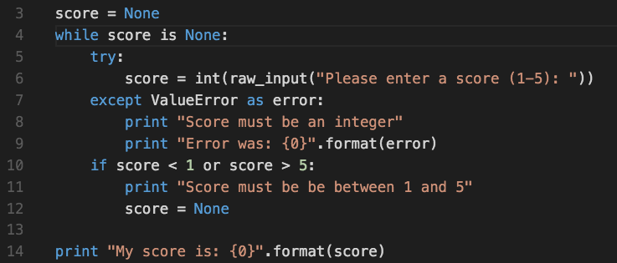
Let’s make an exception

Slide 9
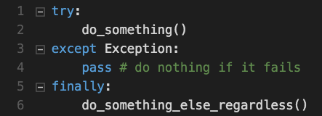
Anatomy of an exception handler:
Try to do something
If that fails do something else (or don’t)
Finally, optionally, do something else
You can have multiple except blocks for different exceptions

Slide 10
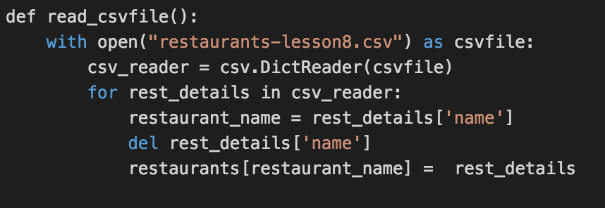
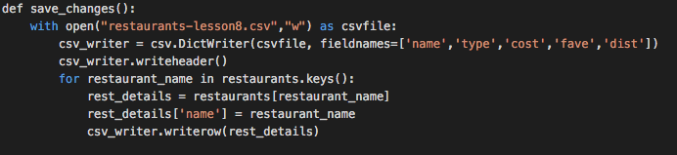
Writing it all back out again
Spot the difference?

Slide 11
Just in case…
That if statement to select from the menu is getting pretty unwieldy
Any suggestions?

Slide 12
Just in case…
That if statement to select from the menu is getting pretty unwieldy
Any suggestions?
Python doesn’t have a case statement. if … elif ... else is supposedly good enough.

Slide 13
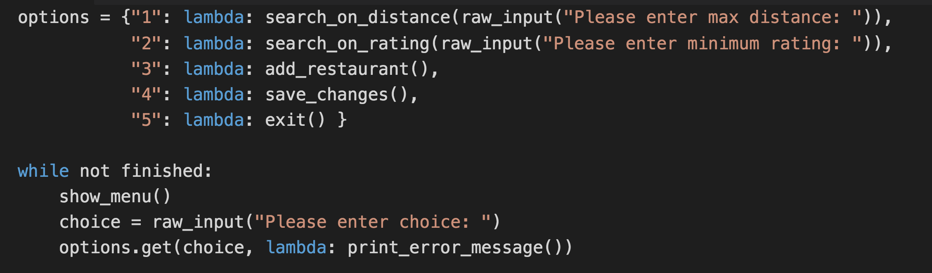
Sacrificial lambdas
A lambda is an expression that’s treated as if it were a function.
What happens if we miss the lambda keyword out?
What does the last line do?
There’s one major advantage gain by using a dictionary as a case statement. What is it?

Slide 14
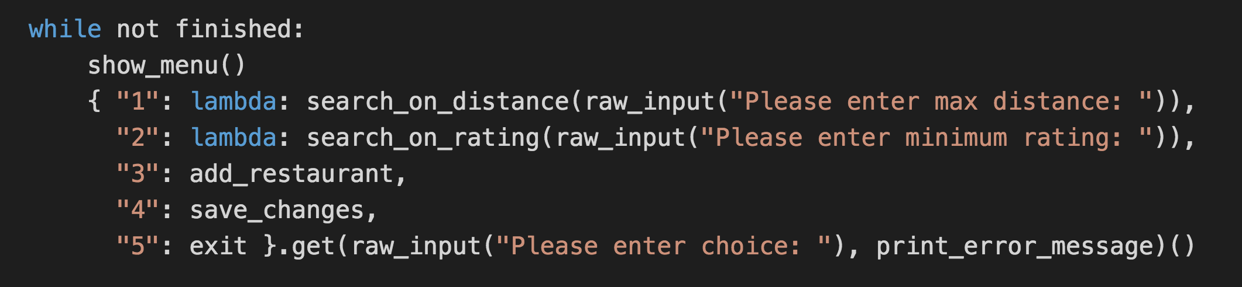
And what about this?
This does the same as the previous slide.
We only need to use lambda if we’re supplying an argument
We can supply bare function names as references in other places
There’s more than enough evil in the world. Don’t do this.

Slide 15
In next week’s episode
How to write classy code
Some bloke called Jason
Drop–In: Monday, 11-12, S32

